Slide 1
Hexagonal Hive: Premium Candle Maker
Brenden Deutschman and Edgar Tejada

Slide 2
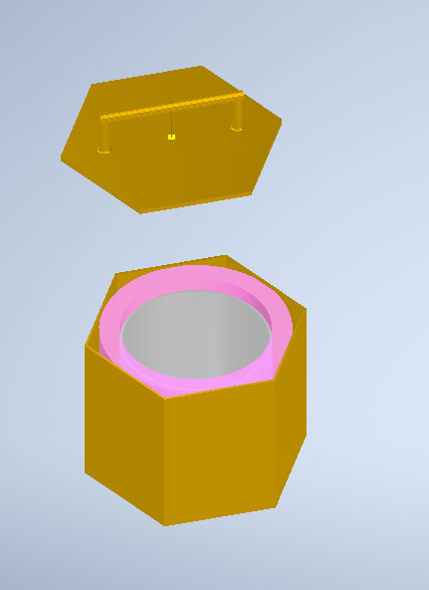

Hexagonal Hive: A Premium Candle Making Machine for Consumers

Slide 3


Slide 4
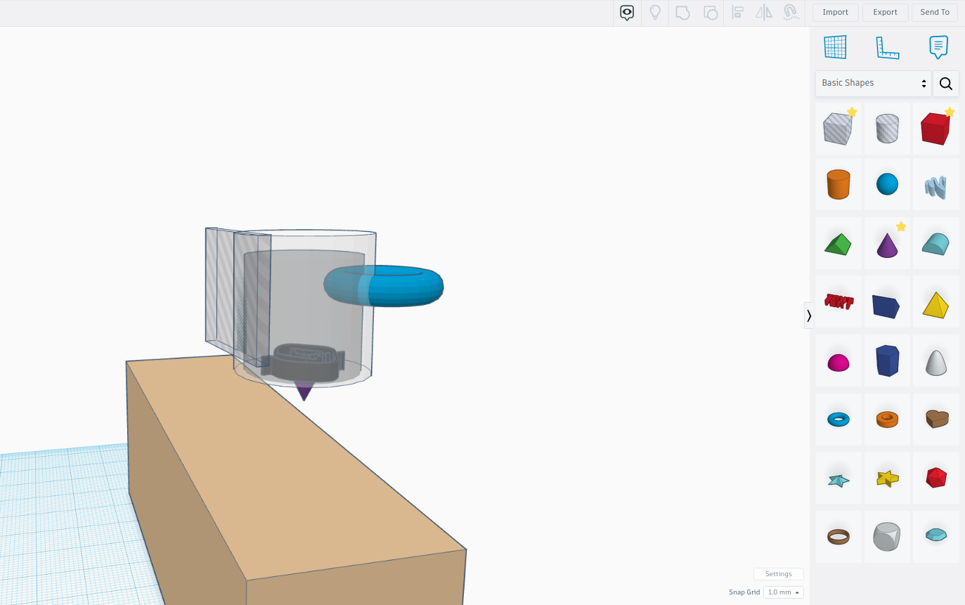
Concepts 1: Wall Mounted Candle Machine
https://www.tinkercad.com/things/4ZpfnSgwqOI-frantic-luulia/edit?sharecode=S2A3ATSwqdlovOBXc6H9YNf4GPVZWfCdQWAx5xJYl_U
Notes:
Edgar

Slide 5
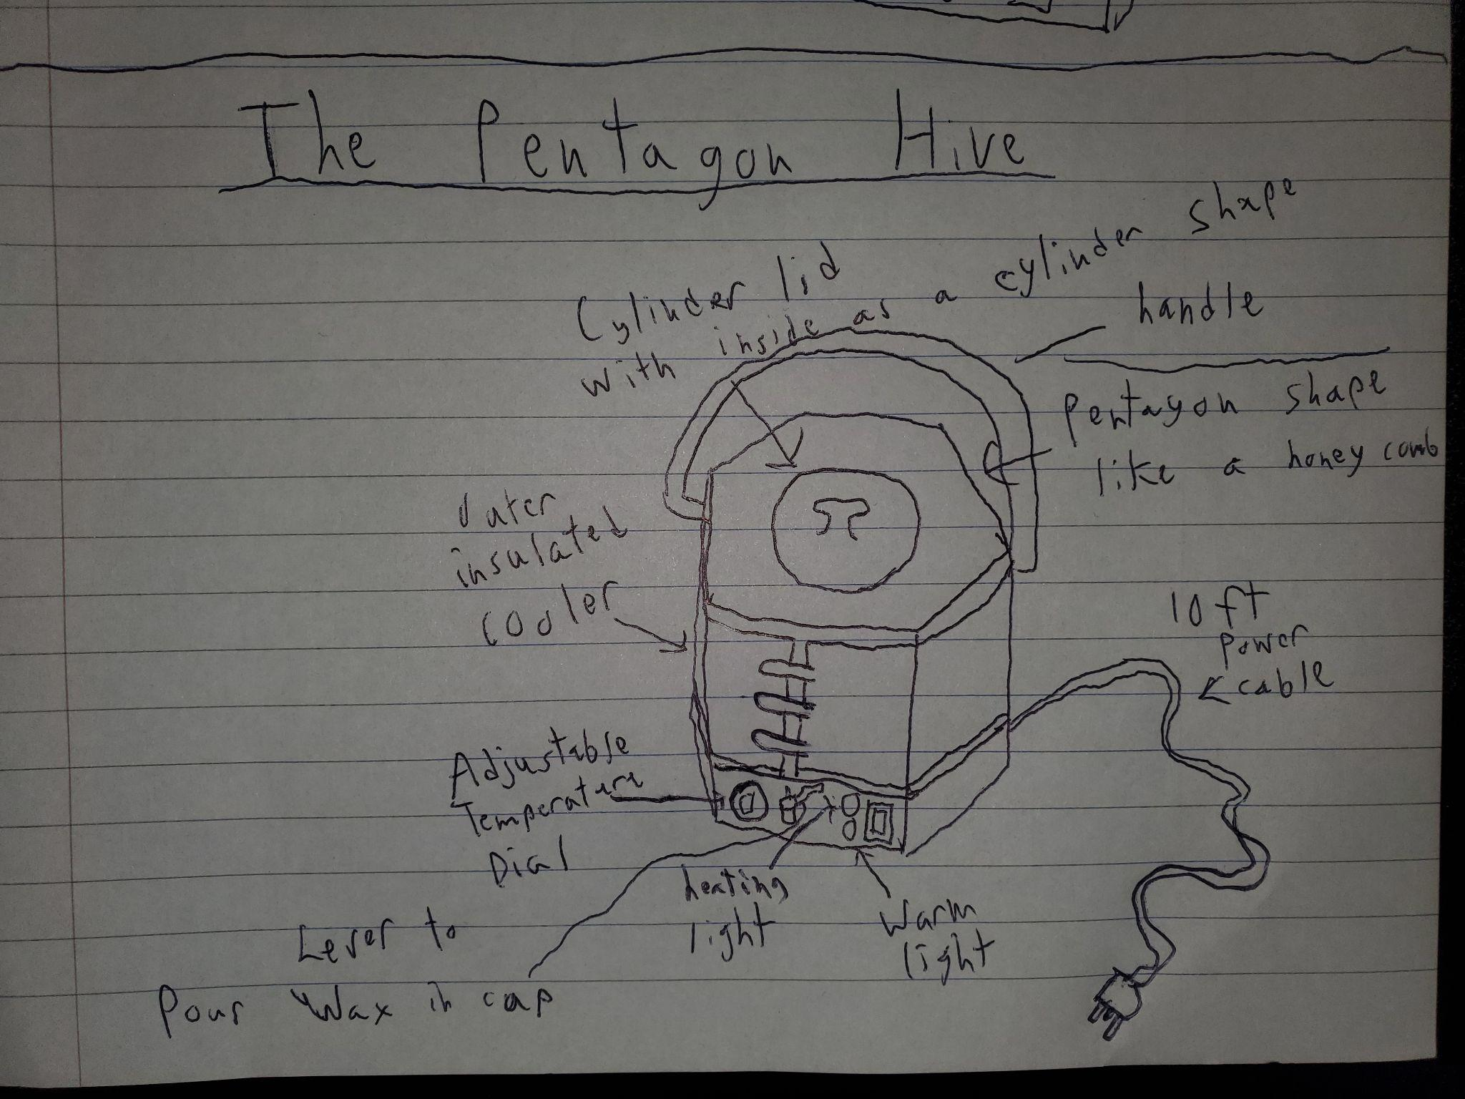
Concepts 2: Tabletop Candle Machine
Notes:
Brenden

Slide 6


Rating Criteria
Goal | Cost | Size | Ease of Use | Safety | Durability | Attractive |  | Score | % Importance
Cost |  | 1 | 0 | 0 | 1 | 0 |  | 2 | 13.33%
Size | 0 |  | 0 | 0 | 1 | 0 |  | 1 | 6.67%
Ease of Use | 1 | 1 |  | 0 | 1 | 1 |  | 4 | 26.67%
Safety | 1 | 1 | 1 |  | 0 | 1 |  | 4 | 26.67%
Durability | 0 | 0 | 0 | 1 |  | 0 |  | 1 | 6.67%
Attractive | 1 | 1 | 0 | 0 | 1 |  |  | 3 | 20.00%
% Importance | 13.33% | 6.67% | 26.67% | 26.67% | 6.67% | 20.00%
Names: Brenden Deutschman and Edgar Tejada
Project: The Hexagon Hive
Notes:
Both

Slide 7

Criteria Selection
Goal |  | Cost | Size | Ease of Use | Safety | Durability | Attractive |  | Score
% Importance
Wall-mounted Candle Maker (Edgar) | Rating (1 to 10) | 3 | 4 | 7 | 5 | 7 | 6
 | Score | 0.40 | 0.27 | 1.87 | 1.33 | 0.47 | 1.20 |  | 4.33
Hand-held Candle Maker (Brenden)
 | Rating (1 to 10) | 6 | 5 | 6 | 7 | 5 | 5
 | Score | 0.80 | 0.33 | 1.60 | 1.87 | 0.33 | 1.00 |  | 4.93
Winner:
Hand-held Candle Maker
Notes:
Both

Slide 8
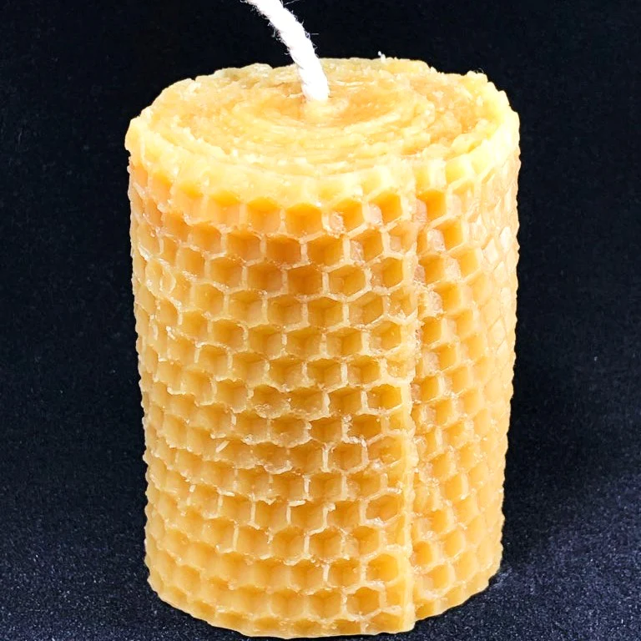
Design Goals
Who is the customer?
Candle Enthusiast like Ms. Ray
What are their needs?
Consumes a large, premium candle every two weeks.
Notes:
Brenden

Slide 9
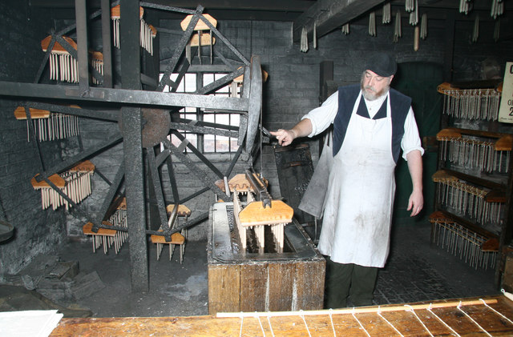
Design Requirements
1. Intended for indoor, home consumers candle making.
2. Able to pour melted wax into any candle mold desired. Should hold a gallon of wax.
Notes:
Edgar

Slide 10
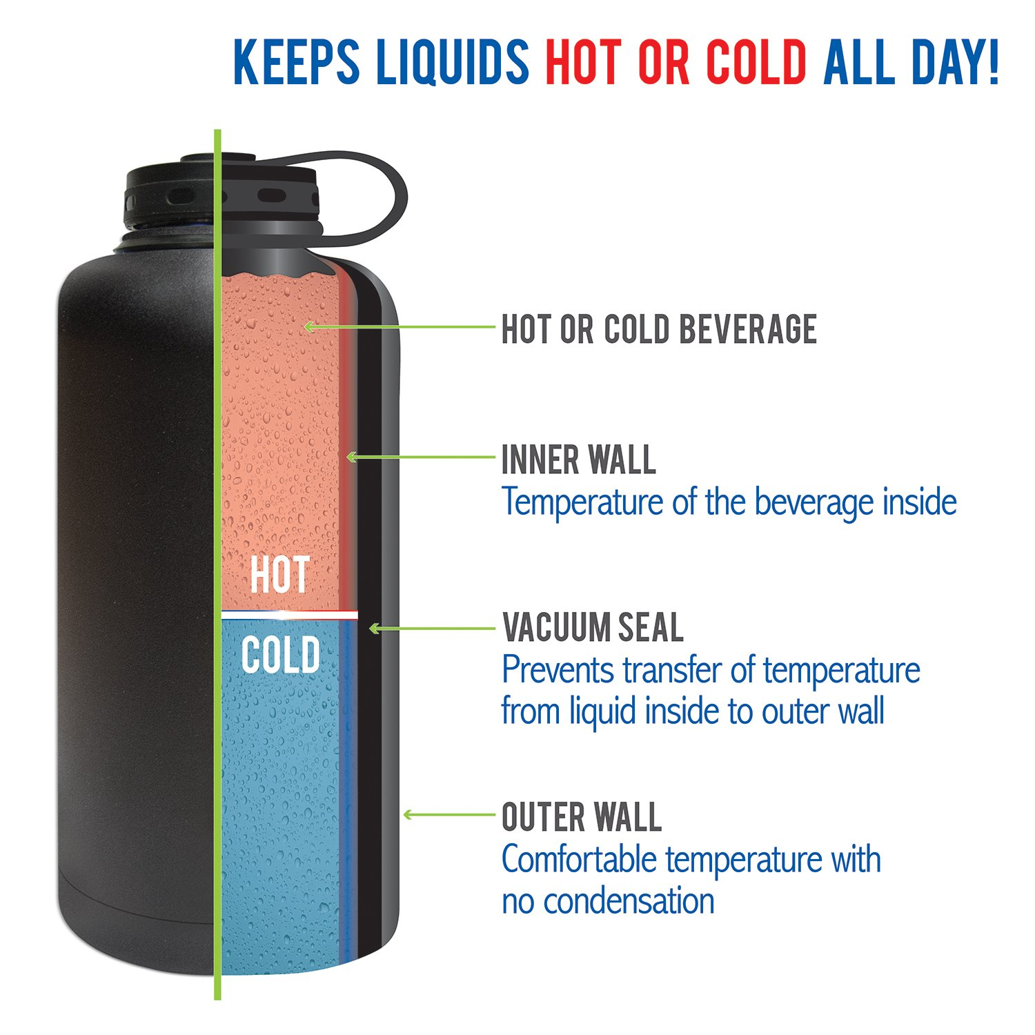
Design Requirements
3. Insulated to keep a batch of molten wax liquid for up to 4 hours.
4. Outer shell should be safe to touch during operation
Notes:
Edgar

Slide 11
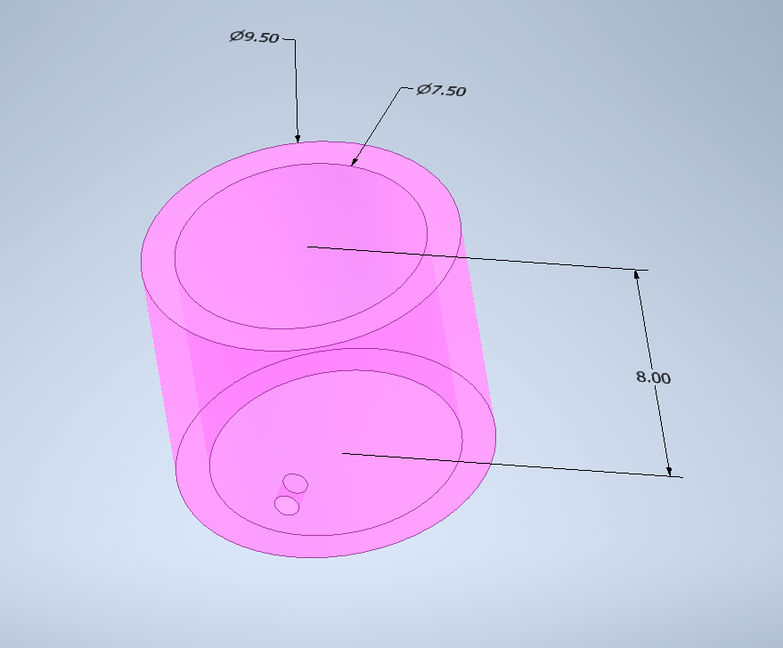
Design Requirements:
Show Insulation Part in Detail
Notes:
Edgar

Slide 12


Design Requirements
5. Should be powered by AC electricity with a 12 foot power cable.
6. Should have a controlled temperature range for wax between 200 F and 300 F.
Notes:
Brenden

Slide 13
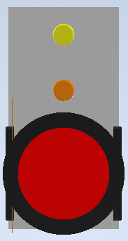
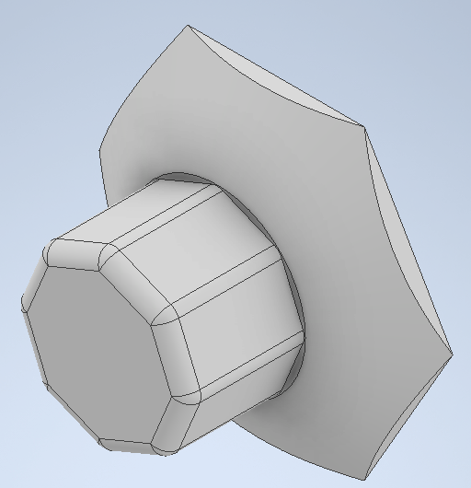
Design Requirements:
Temperature Control Panel
Notes:
Brenden

Slide 14


Design Requirements
7. Should be less than 25 lbs when empty.
8. Should have a thermally insulated, manual control valve.
Notes:
Brenden, speak about safety for a customer like his mother.

Slide 15
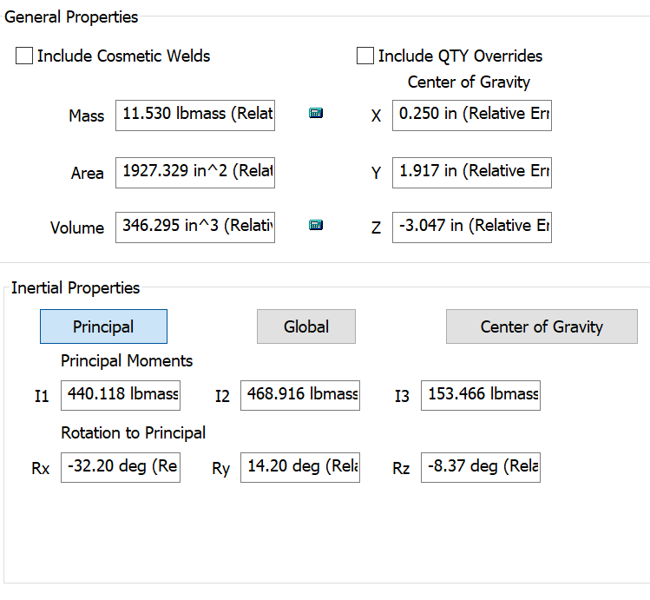
Design Requirements:
Show Screenshot of Inventor Mass Break Down
Notes:
Edgar talks about Inventor’s mass estimates, vs xometry’s mass estimates

Slide 16
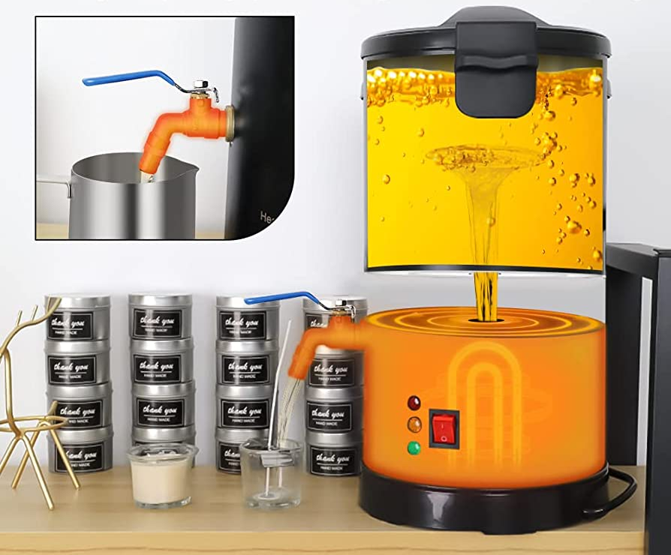
Design Requirements
9. Visual notification for when it is on and when it is hot
10. Internal metal cooking container and metal hot end nozzle must be chemical inert to most waxes
Notes:
Brenden

Slide 17
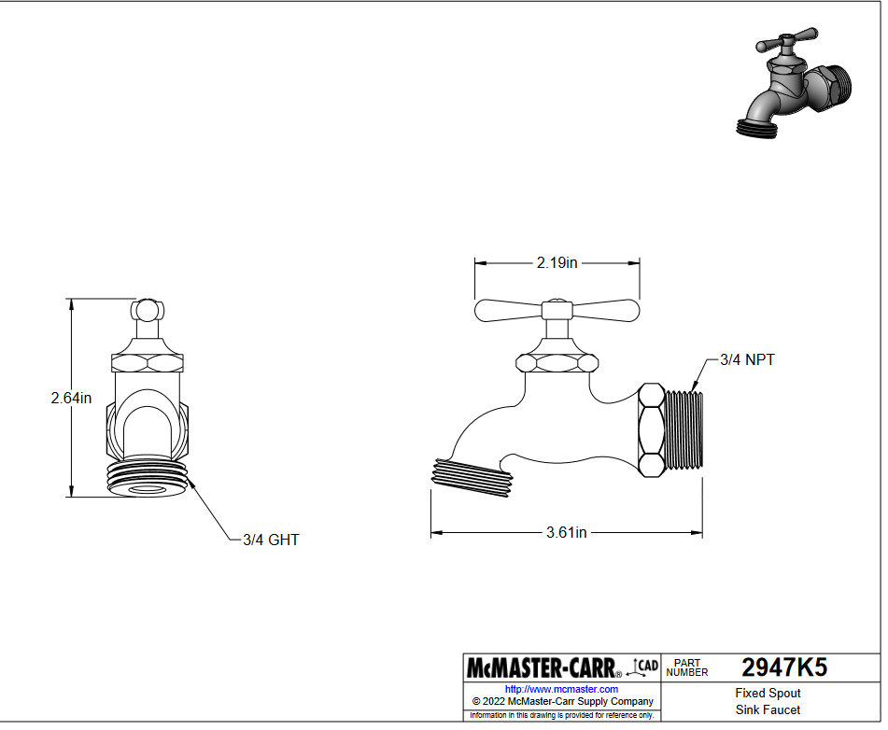
Design Requirements:
Show Nozzle and Valve in Inventor
Notes:
Brenden

Slide 18

Design Requirements
11. Must have a simple feed or insert mechanism to insert the wick.
12. Should be more cost effective per candle than buying an equal volume of store bought candles (in 5 years).
Notes:
Edgar

Slide 19
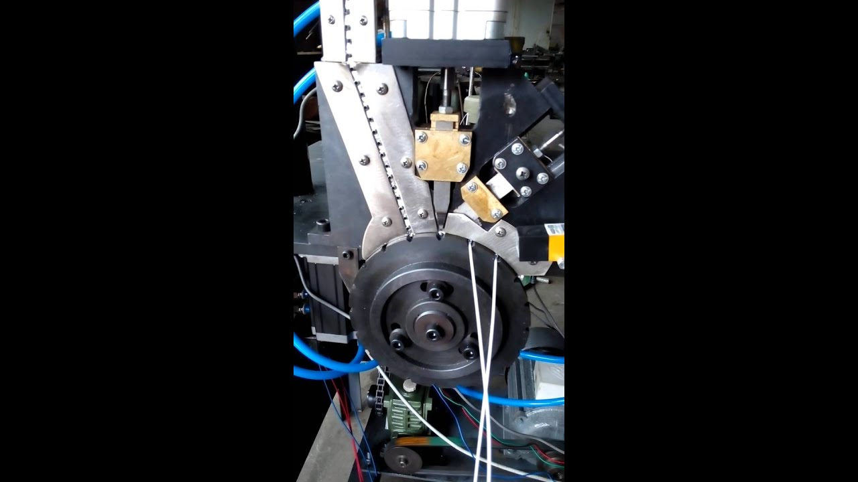
Design Requirements: #11
Wick Insertion and Cutting Mechanism, to be implemented.
Notes:
Edgar

Slide 20

Customer Cost Saving (#12)
Price to Beat: $10/ (2 Weeks) * (5 Years) = $1303.57
Cost of wax:
Mass of wax: 10 oz/ (2 Weeks) *(5 years) = 1303.57 Oz ~= 81.5 lbs of wax
Cost of units of wax and wicks is: $25.69/5lbs
Cost of Material = 81.5 lbs * ($25.69/ 5 lbs) = $418.79
Budget for Machine = Price to Beat - Cost of Material
Budget for Machine $1303.57 - $418.79 = $884.78
We are well under that, with a manufacturing cost of $165.18
Notes:
Both

Slide 21
Layout Drawing
Line Item | Material | Mass (lbmass) | Method of Production | Estimated Cost | Notes
Hexagonal Shell | Aluminum | 4.99 | Sheet Metal | $61.93 | Assuming 5000 units
Inner Insulation | Fiberglass Foam | 1 inch thick, inner radius is 7.25 | Cut and Rolled | $28.21 | 310.3 in^2 surface area
Inner Hotpot | Aluminum | 2.56 | CNC Machining | $65.99 | Assuming 5000 units
Heating Element | Steel | 1.1 | Purchased | $3.00 | Assuming 5000 units
Temperature Control Chipset | Various | 0.001 | Purchased | $0.70 | Assuming 5000 units
Buttons | Steel | 0.06 | Purchased | $0.35 | Assuming 5000 units
Lights x2 | Gallium Phosphide (GaP). | 0 | Purchased | $0.03 | Assuming 5000 units
Faucet | Acetal Plastic | 0.079 | Purchased | $6.93 | Assuming 5000 units
Temperature Dial | Aluminum | 0.006 | CNC Machining | $4.97 | Assuming 5000 units
Material Costs Per Unit: | Assuming 5000 units made
$172.11

Slide 22
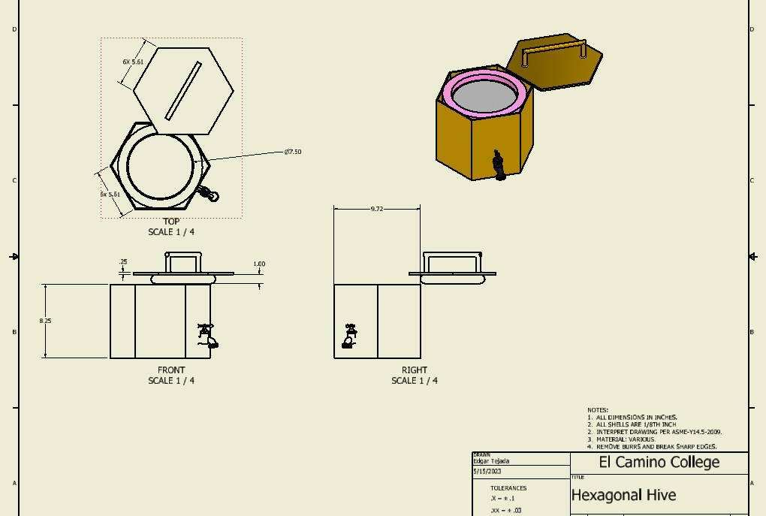
Layout Drawing
Notes:
Both

Slide 23

Questions
Any questions?
Notes:
Both

